Slide 1
AWS Essential Program | Jan 2021 - Batch 1 Assignment - 1
Pavan Gantakoru

Slide 2


Slide 3
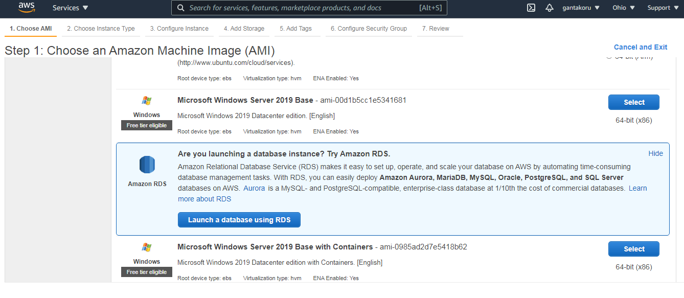

Slide 4
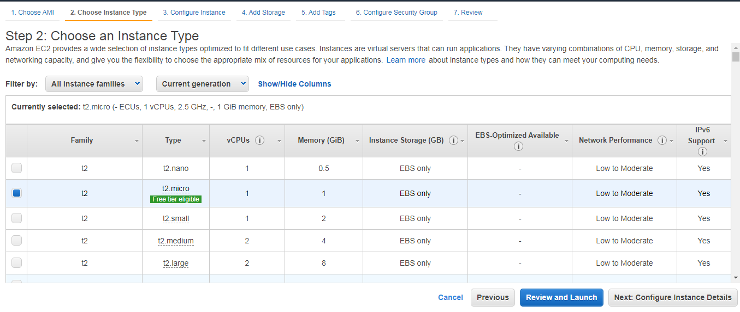

Slide 5
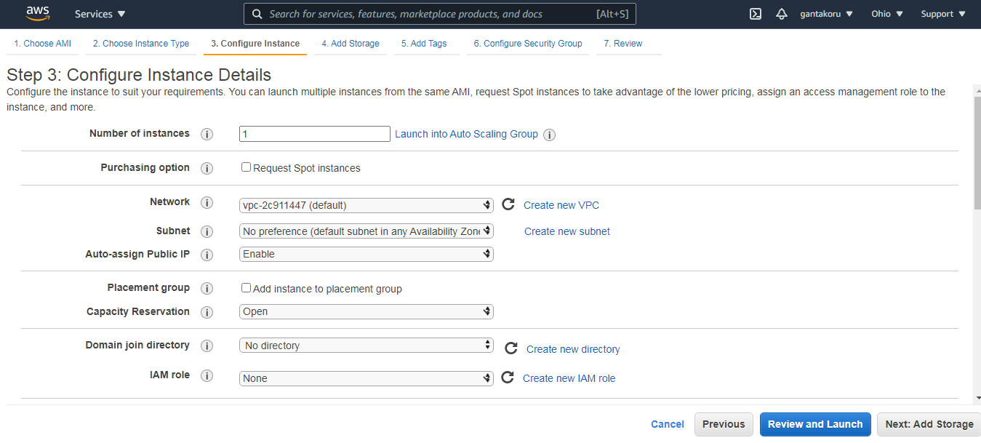

Slide 6
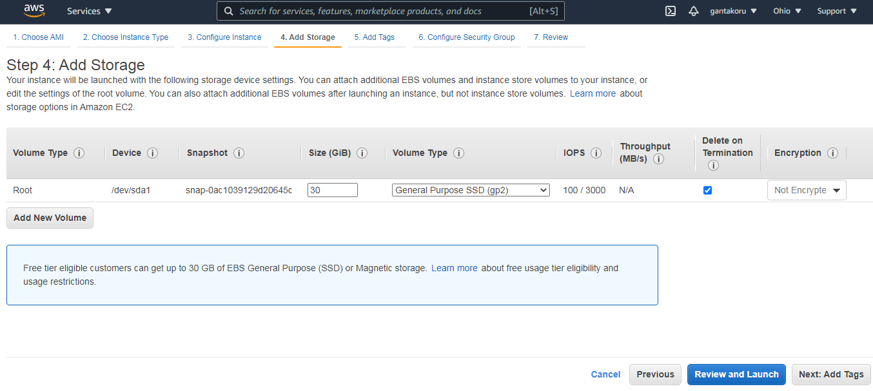

Slide 7
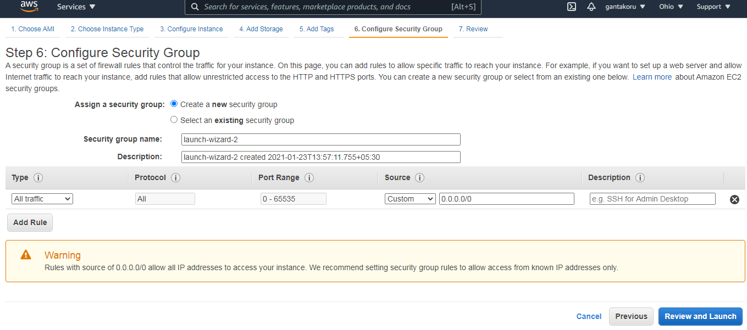

Slide 8


Slide 9
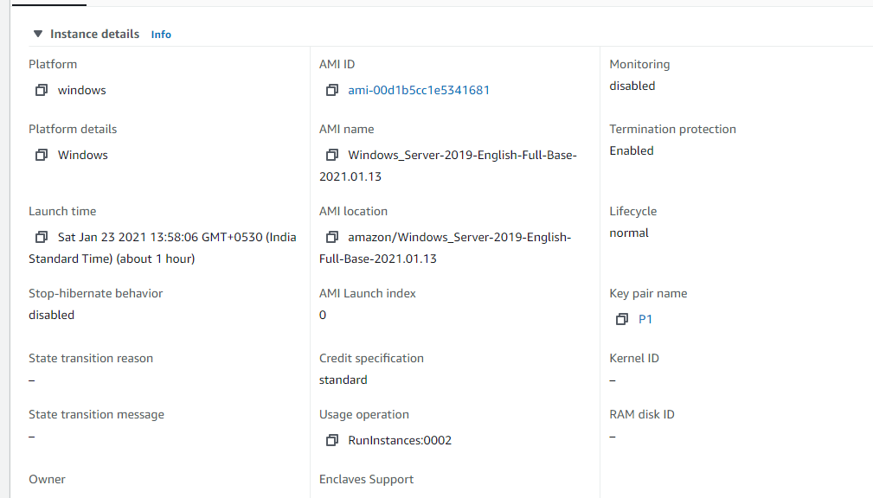

Slide 10
